Slide 1

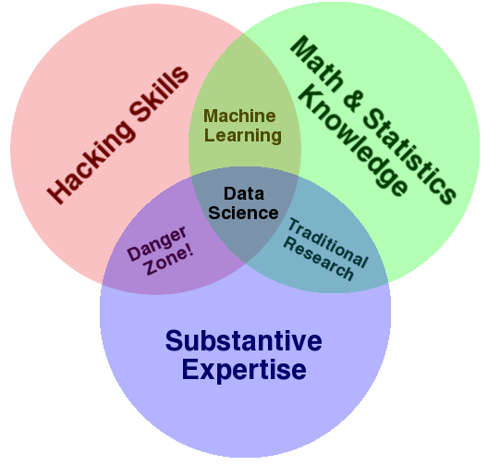
CUSTOMER CHURN PREDICTION
BY
ANKIT NITESH
Data- Science & Analytics

Slide 2
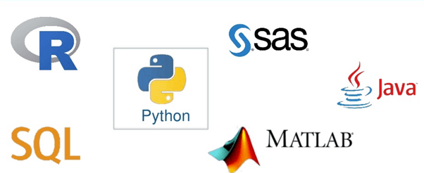
INTRODUCTION
The market is very dynamic and highly competitive.
It is very easy for customers to switch from one
service provider to another for a better price rates
or service quality.
Companies are aware that attracting new customers is much more costly than keeping current customers

Slide 3

What is Churn?
Customer churn is define as the lose of customers.
In business, “customer churn” is a term commonly refers to customers who stop using some services or terminate their contract and subscription with a company to switch to another competitor .

Slide 4
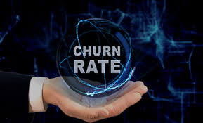
Churn Management and Prediction
The goal of churn management is to keep current customers as long as the
company is alive in the market.
Revenue comes from the creation and maintaining long-term relationships with
the customers.
A better churn management can help Customer Relationship Management (CRM) in
decision making and establishing effective customer retention campaigns.

Slide 5

Our Target
We need to identify (predict) those customers who are probably will leave.
Specific marketing campaigns could be designed to target the most risky customer segments.
Special discounts and subscriptions could be offered.

Slide 6

From Where to start?
Detecting a churn by observation is almost impossible.
Traditional surveys based on running questionnaires or
interviews suffer from a high cost, limited access to customer
population and data self-reporting
Telecom companies realize that their existing customer database is the key.
Service providers started to invest more in data mining
techniques that can aid in having an efficient churn prediction
models.

Slide 7

CHALLENGES
The available data is imbalanced.
Different no. for dataset for each feature.
High number of related variables.
Big Data

Slide 8
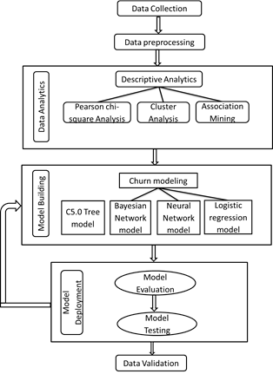
Working of the Model
Data Extraction
Data merging
Data Pre-processing
Data analytics
Modelling
Accuracy

Slide 9
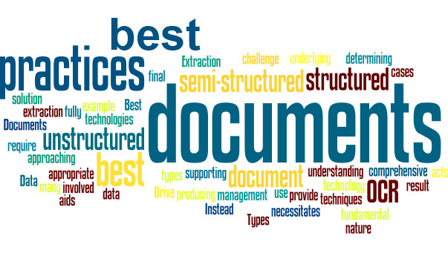
Data Extraction
Data extraction is where data is analyzed and crawled through to retrieve relevant information from data sources (like a database) in a specific pattern. Further data processing is done, which involves adding metadata and other data integration; another process in the data workflow.
The majority of data extraction comes from unstructured data sources and different data formats. This unstructured data can be in any form, such as tables, indexes, and analytics

Slide 10
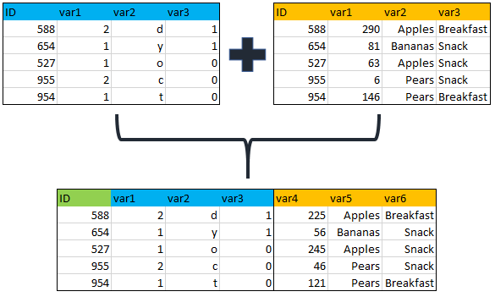
Data merging
Data merging is the process of combining two or more data sets into a single data set. Most often, this process is necessary when you have raw data stored in multiple files, worksheets, or data tables, that you want to analyze all in one go.

Slide 11
Data Preprocessing
Data pre-processing is a data mining technique which is used to transform the raw data in a useful and efficient format. The phrase "garbage in, garbage out" is particularly applicable to data mining and machine learning projects.
We fill null values by:-
Mean
Median
Mode
And doing treatment using Standardization and normalization.

Slide 12
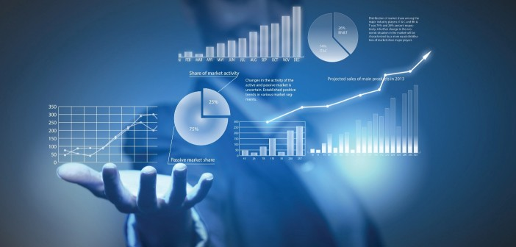
Data Analytics
Data analytics is the science of analysing raw data in order to make conclusions about that information. Many of the techniques and processes of data analytics have been automated into mechanical processes and algorithms that work over raw data for human consumption.
We will use pairplot, countplot,box plot pie chart, heatmap for analysis

Slide 13
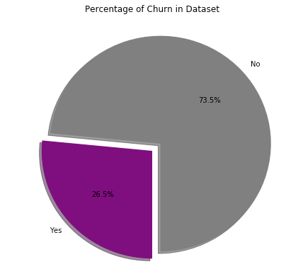
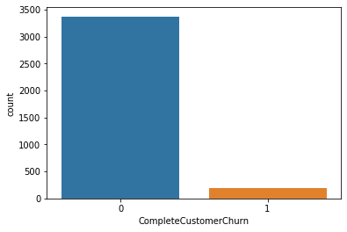
Different Tools for Analysing Dataset
(a) Churn Vs Not Churn
(b)Pie - Chart

Slide 14
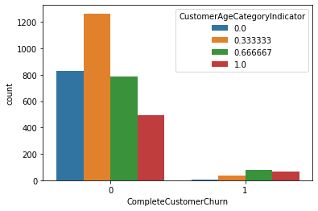
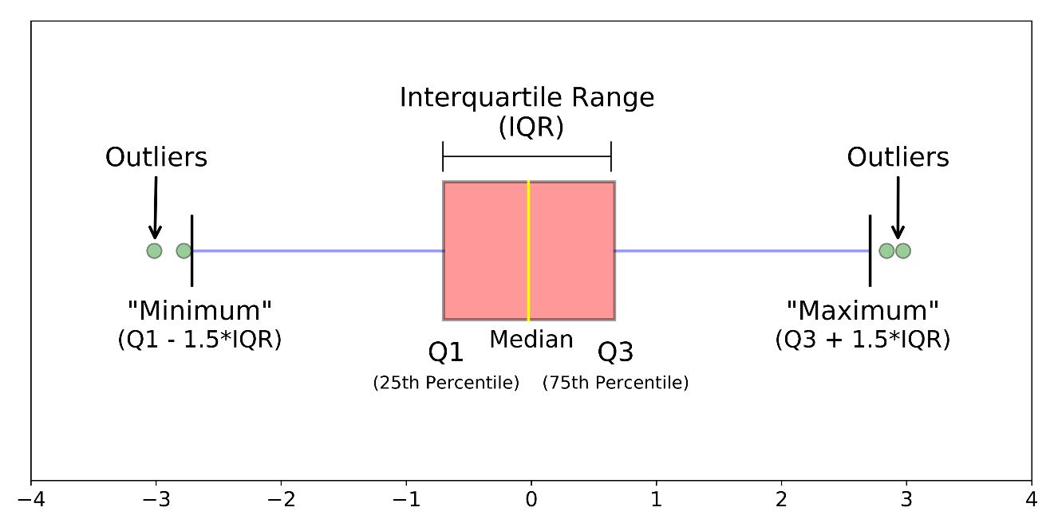
(c)Countplot
(d) Boxplot

Slide 15
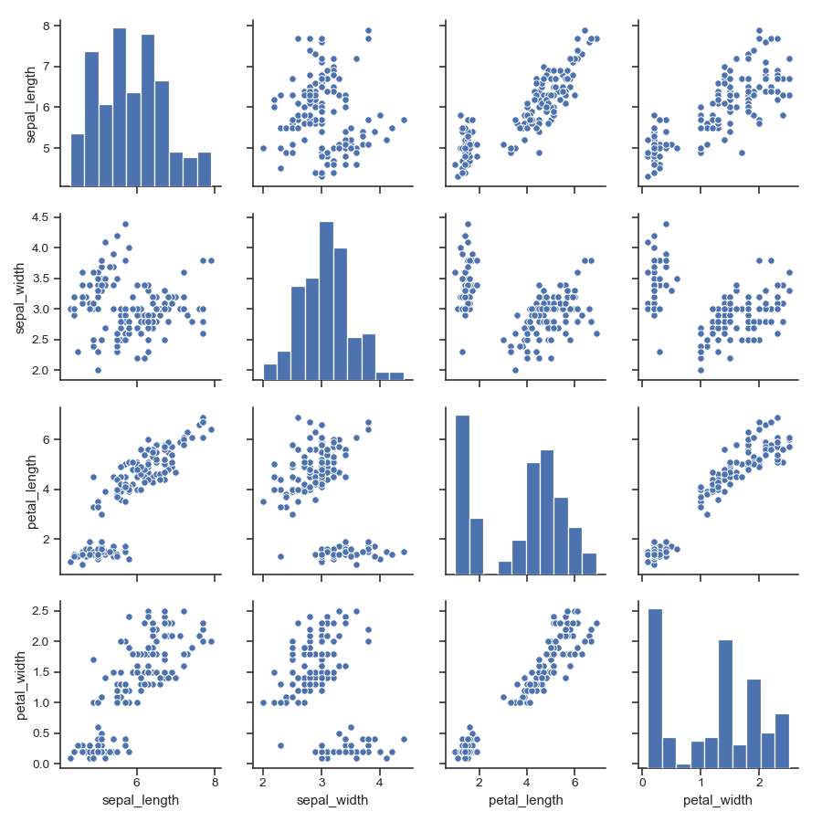
(e) Pairplot

Slide 16
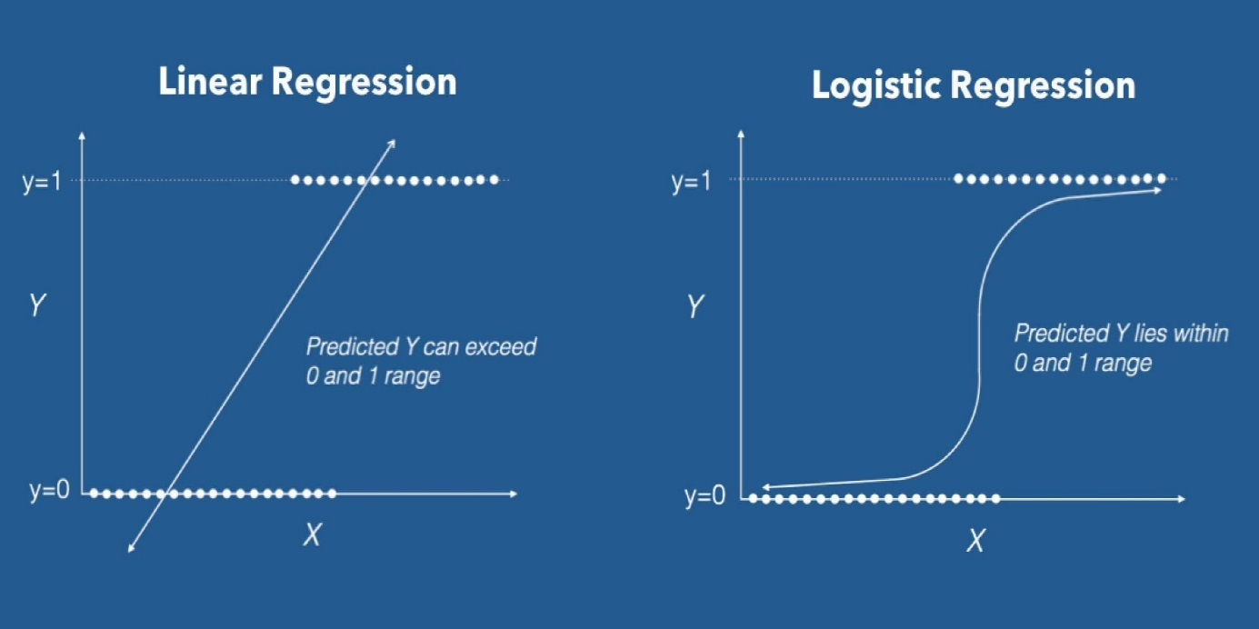
Modelling
Logistic regression
It is a classification algorithm used to assign observations to a discrete set of classes. Some of the examples of classification problems are Email spam or not spam, Online transactions Fraud or not Fraud, Tumor Malignant or Benign. Logistic regression transforms its output using the logistic sigmoid function to return a probability value.

Slide 17
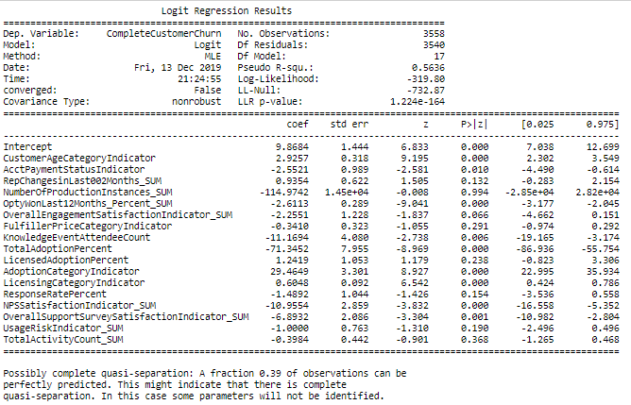
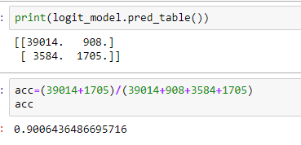
Summary with initial accuracy(90%)

Slide 18
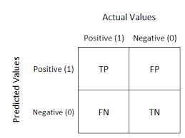
How to find Accuracy?
We will find accuracy by using confusion Matrix.
Now, What is Confusion Matrix ?
A confusion matrix is a table that is often used to describe the performance of a classification model (or "classifier") on a set of test data for which the true values are known. The confusion matrix itself is relatively simple to understand, but the related terminology can be confusing
Accuracy = TP + TN
TP + FP + FN +TN

Slide 19
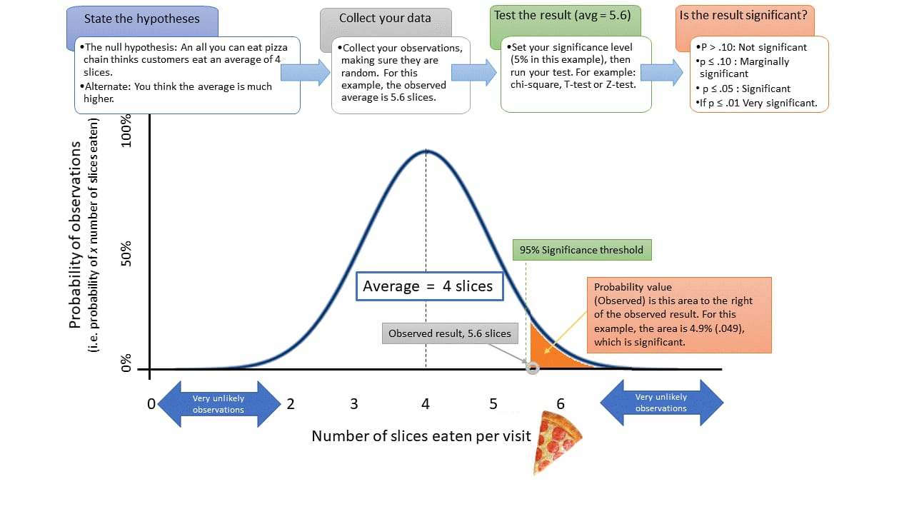
What is p-value?
When you perform a hypothesis test in statistics, a p-value helps you determine the significance of your results. Hypothesis tests are used to test the validity of a claim that is made about a population. This claim that’s on trial, in essence, is called the null hypothesis.

Slide 20
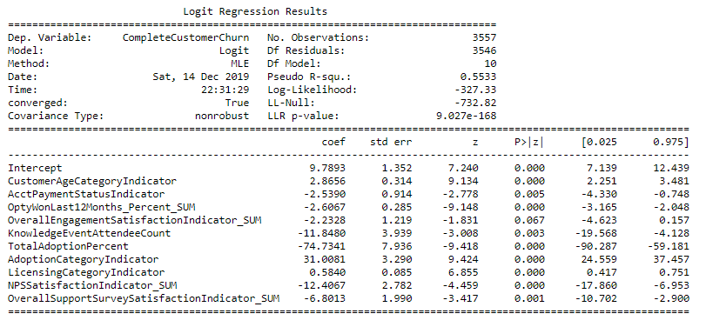
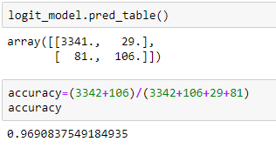
Final Accuracy by removing features having p-value greater than 0.05
Model prediction successful with 96.90% accuracy.

Slide 21

Data- Science & Analytics

